Slide 1


MuziqueHub

Slide 2

Passport Authentication
SVG Animation

Slide 3
Login/Signup
Stores user info in database
Songkick API
Can search by artist or location
Concert Search Page
Home/ Artist Search Page
Favorites Page
Can only be accessed if logged in
AudioDB API
Saves favorite artists in Database and displays on favorites page

Slide 4
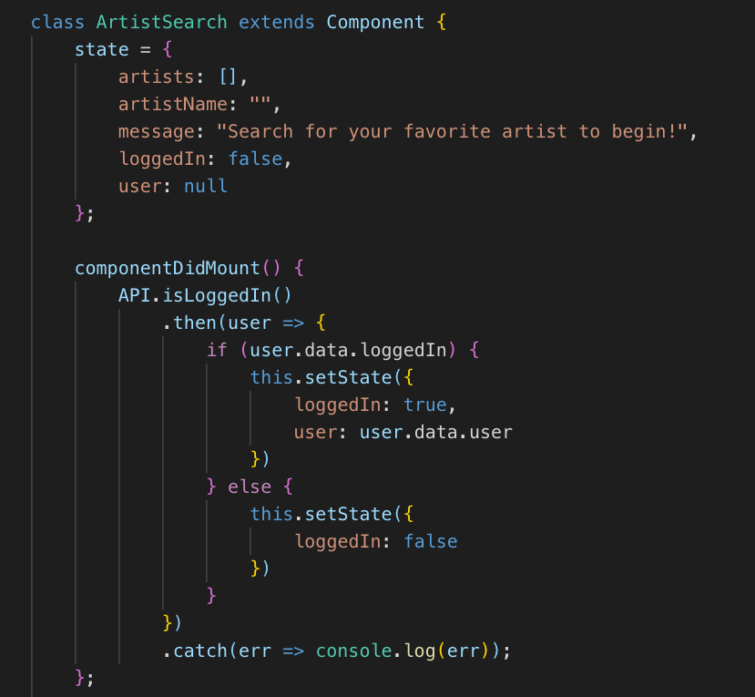
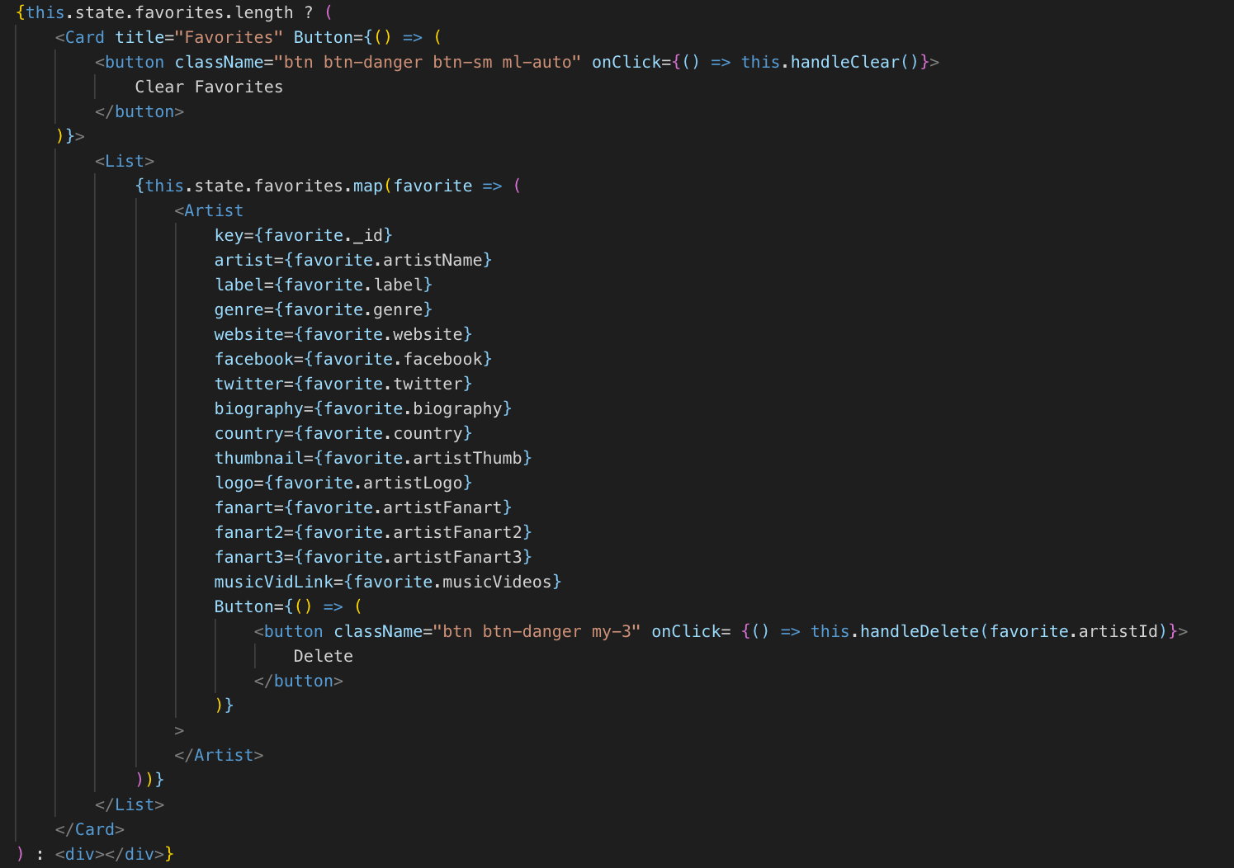
Songkick API Search
Saved artist Info and delete from saved button
Stateful Artist Search Component
If statement checking for login

Slide 5


Thank You!
MuziqueHub
Amanda Dovel
Joey Kubalak
Kyle Knox

